Slide 1
Setting up a Business
Unit 5- Chapter 16

Slide 2

What are the main ownership option of a business ?

Slide 3
Business Ownership
Sole Trader: own and manage their own business
Partnership: two or more people (not more than 20) are in business together in order to make a profit
Limited Companies (Ltd): businesses registered with the companies registration office that are owned by shareholders
Co-operatives: democratically owned and controlled by members who may be workers, suppliers or customers

Slide 4
Characteristics of businesses
 | Sole Trade
Formation & Dissolution | Registered for Tax with the Revenue Commissioners Have to register business name if different from sole Traders Has no continuity of existence if sole trader dies
Control | Owned and controlled by sole trader who makes all the decisions
Finance | Can only raise equity finance (money) by investing personal finance
Profits & Risk | Keeps all the profits . Pays income tax on profits. Has unlimited liability (risk)

Slide 5
 | Partnership
Formation & Dissolution | Registered for Tax with the Revenue Commissioners Have to register business name if different from partners name Has no continuity of existence if partners dies or leaves
Control | Owned and controlled by partners who make all the management decisions
Finance | Can raise equity finance (money) by brining in new partners
Profit & Risk | Partners share all the profits and pay income tax on their shares. Partners have unlimited liability of all debts in the business

Slide 6
 | Private Limited Company (Ltd)
Formation & Dissolution | Registered for tax with revenue Registered company with the companies registration office Company continues to exist regardless who owns shares
Control | Owned and controlled by shareholders who elect Board of Directors to run the business
Finance | Equity finances can be raised by selling shares
Profits and Risk | Company pays corporation tax on profits Profits shared out according to the amount of shares owned Shareholders pay income tax on dividends Shareholders have limited liability

Slide 7
 | Co-operative
Formation and dissolution | Registered for tax with the revenue Registered with the companies registration office Continues to exist regardless of who owns the shares
Control | Owned and controlled by members who elect management committee
Finance | Equity capital can be raised by brining in new members
Profits & Risk | Pays corporation tax on profits Profits distributed among members Members pay income tax on dividends Members have protection of limited liability

Slide 8

Finance
What factors should an entrepreneur choose when considering a type of finance(invested/borrowed money) for start up a business ?

Slide 9
Choosing Finance
Entrepreneurs should consider:
Purpose: type of finance should match the purpose for which it will be used for
Cost: how much will the interest payments be? How will it effect product and profitability?
Control: how much will the investment cost in term of ownership/control (% of the business given away, Dragons Den)
Risk: Potential risk may be inability to pay back a loan , which means losing vital assets/equitpment/loss of business or not being able to pay expenses (wages/tax returns)

Slide 10
Types of Finance
The types of finance needs for a start up business can be:
Short term
Medium Term
Long Term

Slide 11
Short Term Finance
Duration | Sources | Uses
0-1 Year | Trade Credit Bank Overdraft Accrued Expenses | Payment of regular bills such as electricity, rent, wages, stock, creditors etc

Slide 12
Medium Term Finance
Duration | Sources | Uses
1-5 Years | Leasing Hire Purchases Term Loan | Purchases of expensive assets such as equipment, vans and other machinery

Slide 13
Long Term Finance
Duration | Sources | Uses
5+ Years | Equity Capital Grants Debentures | Long term developments of the new business e.g purchasing premises, developing new products, etc

Slide 14
Production Methods
Production Process describes how the production is done. There are 3 main production methods which are:
Job Production
Batch Production
Mass Production

Slide 15
Job Production
Producing a single product at a time , its usually customised to meet the particular needs of the customer e,g Wedding dress/suit, birthday cake or sandwiches
Characteristics:
Needs a very skilled worker to produce the product
Can be more expensive to the consumer
More employee involvement could lead to better job satisfaction

Slide 16
Batch Production
Producing a limited number of identical products at once e.g producing all medium t-shirts then moving onto large t-shirts
Characteristics:
workers do not have to be as skilled
Average cost of production lower than job
Requires more equipment
More efficient and has less waste

Slide 17
Mass Production
Producing an identical product over and over again e.g pens, chocolate bars, paper clips, computers
Characteristics:
Significantly reduced costs and selling price for consumers
Heavy financial investment required to set up
Breakdown in one part of the machinery can cause major delays in production

Slide 18
Subcontracting
Instead of making your own product businesses can subcontract production to outside producers which means:
Finding a supplier to manufacture part of or the entire product for you .
Big companies such as Nike use subcontract to factories in Taiwan, South Korea and other Asian countries

Slide 19
Advantages
Simplifies Management: Management team can be kept small and focus on marketing and identifying new opportunities
Extra production staff not needed
Sometimes it can be a lot cheaper than to use specialist producers
Seasonal Businesses : for example a business that sells Christmas Crackers can avoid the waste of having equipment lying idle for long periods of the year and if they don’t have the machinery

Slide 20
Disadvantages
Less control over the quality and delivery time of goods
Can be more expensive as could be charged a price that includes a profit margin for the subcontractors
Subcontractor may decided to market the product themselves and become a competitor

Slide 21
Why should every business have a business plan and what should be in it ?

Slide 22
Business Plan
Document setting out:
Who is setting up the business
What is the product or service
How is it going to be produced and promoted
Where it is going to be sold
Finance , where is it coming from
How much profit is expected

Slide 23
Importance of a Business Plan
Sets targets for a business and provide a bench mark against to measure performance of the business, also can be useful for business control
Need to raise finance: well prepared BP will help convince investors, banks and grant givers that the business is well thought out and has a strong likelihood of success
Reduces Risk: helps entrepreneur to think through their ideas and anticipate possible problems and how to overcome them

Slide 24
Information in a business Plan
Description of the entrepreneurs/owners/key staff. This includes their skills, experience and personal investment in the business.
Market Descriptions and Analysis: its size, competitors and target market
Description of Product/service: describing its USP that it has over existing products
Production: premises and equipment required, type of production, labour skills and raw materials

Slide 25
Marketing: describe the marketing strategy/mix that will used to appeal to the target market
Management: how the business will be organised and controlled
Costs: cost of premises, equipment and raw materials
Sources of finances needed: Short, medium or long term
Profitability Forecasts: this could include Break Even Chart, cash flow budget, estimates profit/loss accounts and balance sheets.

Slide 26
Why would a start up business fail and what percentage of new start up businesses fail in its first year?

Slide 27
Why Businesses Fail
Poor market research and product development
Underestimating costs
Not having enough finance to fund business during difficult start up phase
Not keeping proper financial accounts
Over optimistic of sales predictions
Getting the Marketing Mix wrong
Not having a well thought out business plan
Having poor management skill (entrepreneurs)

Slide 28
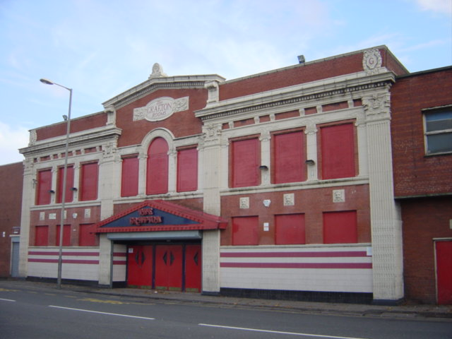
30% of new businesses fail during the first two years of being open, 50% during the first five years and 66% during the first 10.

